Slide 1
Raman Spectroscopy Probe
With In Vivo Applications
Stephen Esposito (CpE)
Michael Gonzalez (EE)
Chelsea Greene (EE)
Megan Melvin (PSE)
Group 8 CREOL

Slide 2
Live Action Safe Examination Raman Spectroscopy - L.A.S.E.R.S.
Advising from Dr. Kyu Young Han
& Dr. Peter J. Delfyett Sponsored by Ocean Optics

Slide 3
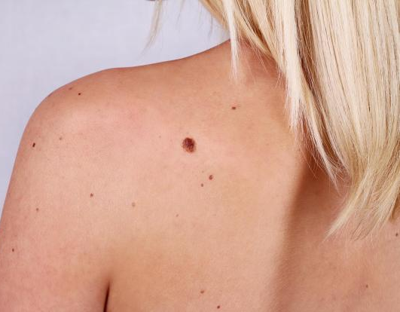
Motivation
Cancer is the 2nd leading cause of death in the U.S.
Skin cancer is the most common type of cancer
Skin biopsies: Invasive, painful, costly
Results may take several days
Pathologist visually inspects biopsy
Why not use light to analytically examine skin?

Slide 4
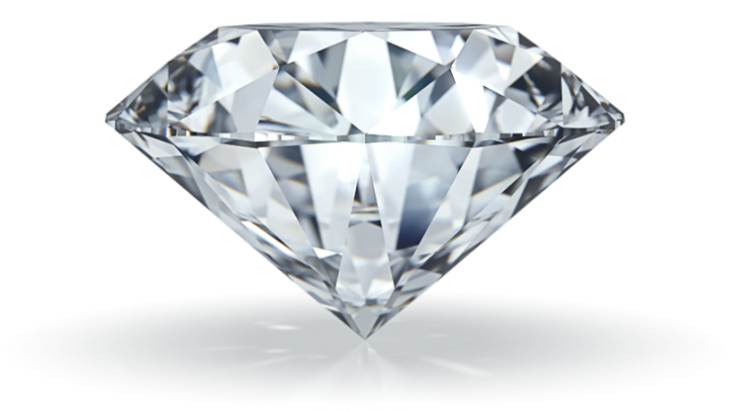
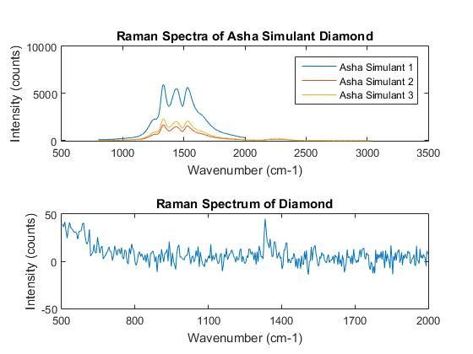
Goals and Objectives
Use Raman spectroscopy to identify two separate, yet seemingly similar objects
The Raman probe can identify the different gemstones diamond, Asha simulant diamond, and a purple gem
Diamond and Asha share a spectral peak at 1333 cm-1
Asha has additional peaks at 1438 cm-1 and 1533 cm-1
Test Results

Slide 5
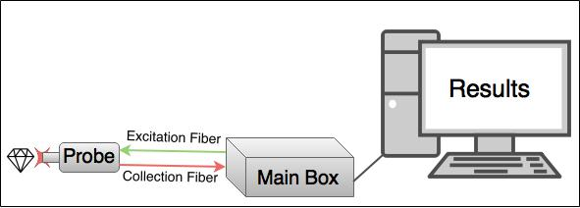
Overall Systemic View

Slide 6
Requirements
Sponsor - Ocean Optics
Improve an on-market device for a target market
Improve the user experience
Improve visibility of sample scanned with camera and LED light
General
Follow all necessary standards
Reliable, effective, ergonomic
Safe, no risk to tested sample or user

Slide 7
Specifications
Computer
User interface & spectroscopy software can run on various market devices
Data sampling and analysis time | < 1 minute
Data analysis accuracy | >75%
Electrical
Modular design to ease troubleshooting
Integrate camera module into system
Voltage within device | ≤ 15 V
System temperature | < 158 ℉ / 70 ℃

Slide 8
Specifications
Optical
Capture Raman signal of samples
Manipulate camera to take macro images, matching focal length of focusing lens
Narrow laser bandwidth to detect nearest Raman shift
Laser power to the sample | > 20 mW
Exposure time to sample | < 30 s

Slide 9
Specifications
General
Handheld probe |  | < 3 lbs (1.4 kg)
Main box fits in typical office environment |  | < 2.5’ x 2.5’
Capture an image of the sample area
Analyse the Raman spectra and discriminate wavenumber differences between samples
Display results in an easy-to-interpret manner
Cost for system in line with medical equipment

Slide 10
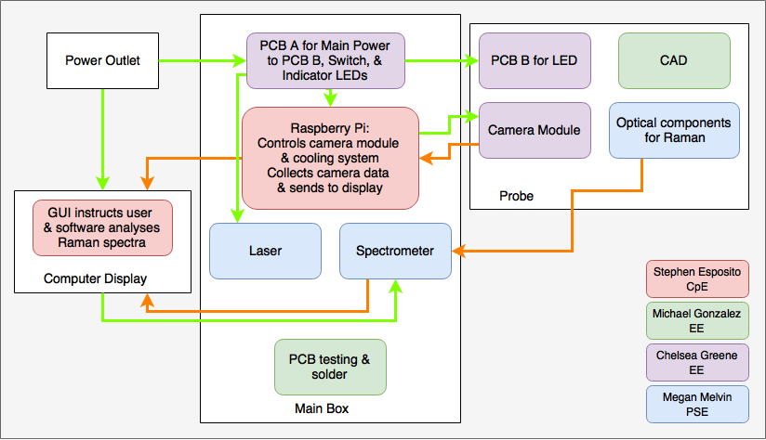
Block Diagram
Data
Power Flow

Slide 11
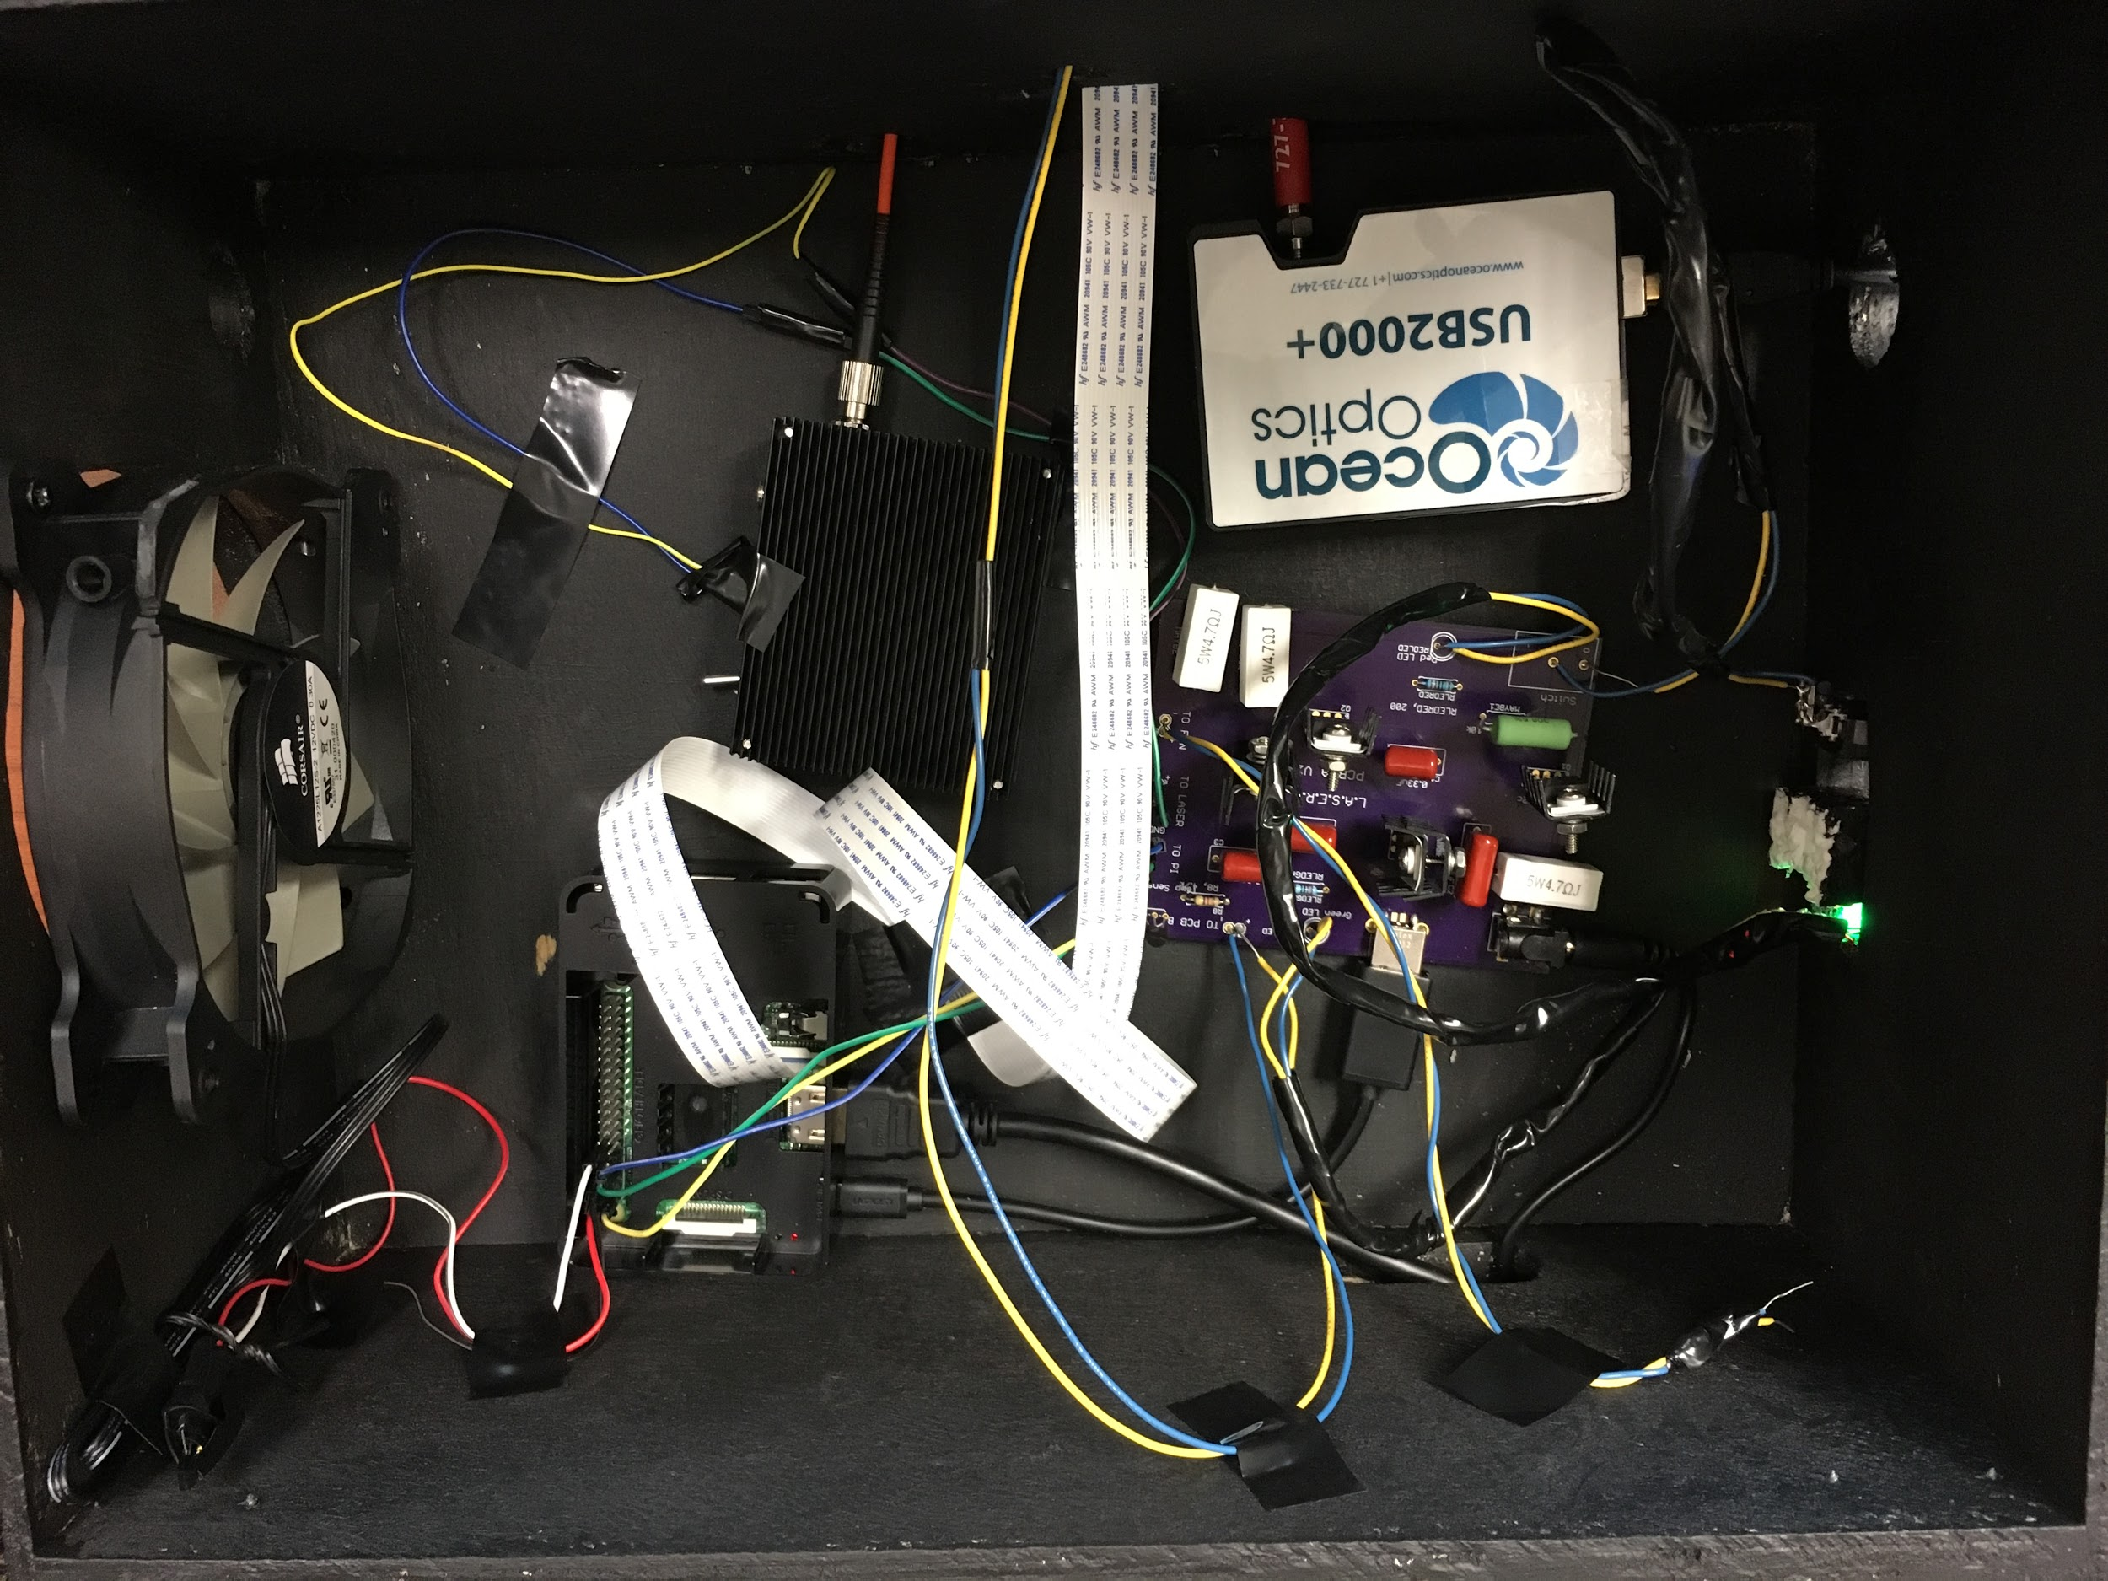
Main Body Components

Slide 12
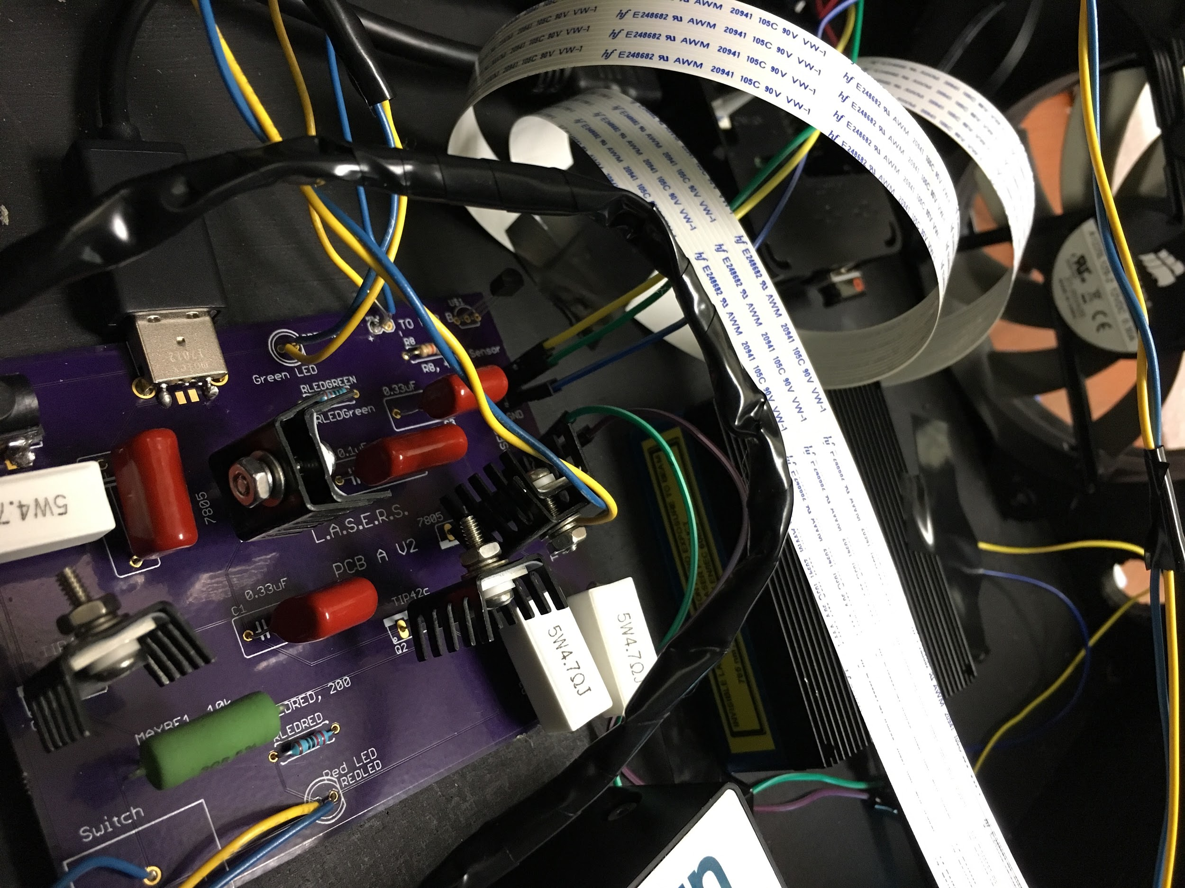
Electronic Elements
Power to Raspberry Pi, laser, fan
Temperature sensor
Power to Raspberry Pi indicator LED
Power to laser indicator LED
Power switch
Camera (in probe)
LED beam (in probe)

Slide 13
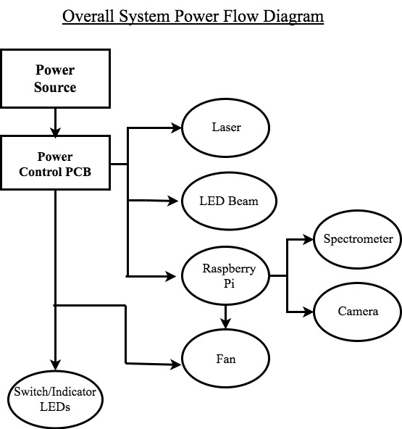
Power Control
Part Name | Minimum Power Required
Laser (785-IP-02-1208) | 3.5 W
Raspberry Pi | 2.5 W
Camera Module | 1.75 W
LEDs (Red and White) | 0.036 W
Spectrometer | 1.25 W
Fan | 1.8 W

Slide 14
Voltage Regulation
Brand | Specific Product | Price Range | Output Current | Max Wattage
STMicroelectronics | L7805CV 5V Regulator | $0.40 | 1.5 A | 7.5 W
STMicroelectronics | L7809CV 9V Regulator | $3.89 | 1.5 A | 13.5 W
Sanken | IC REG BUCK ADJ 3.5A TO263-5 | $2.88 | 3.5 A | 10 W
Texas Instruments | TPS 54302 Switching Converter | $0.60 | 1.0 A | 5 W

Slide 15
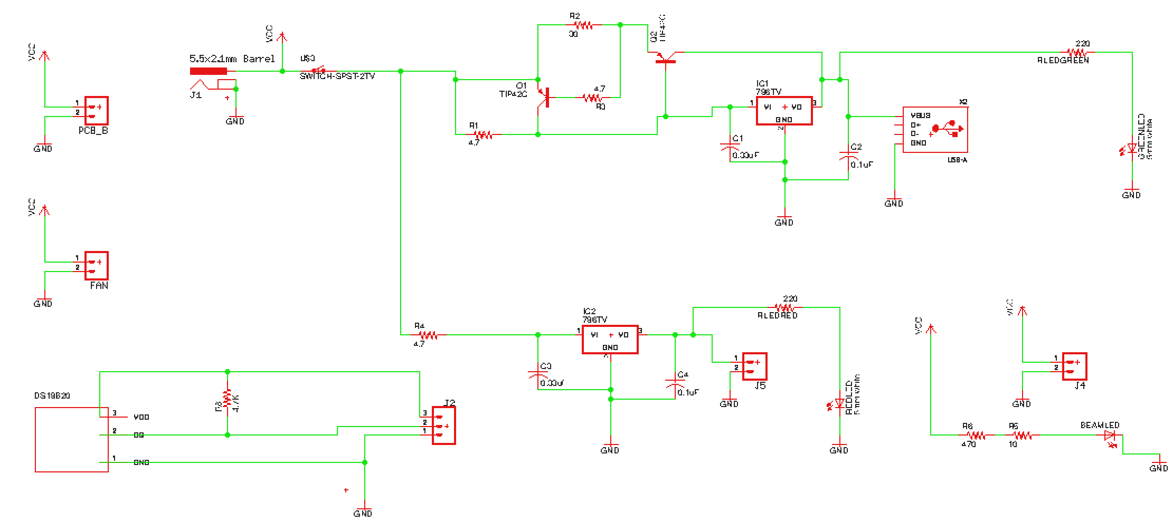

Slide 16
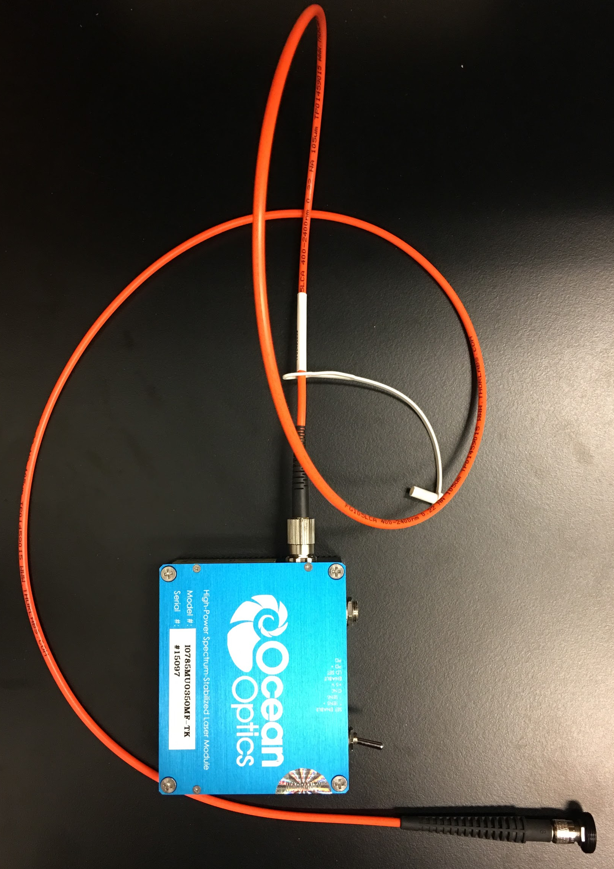
Laser
1 m Fiber
High-Power > 350 mW
Spectrum-Stabilized
Near-infrared 785 nm excitation wavelength
Class IIIb (Class I if enclosed)
Delivers laser light to probe via optical fiber
6.4 cm
7.6 cm

Slide 17
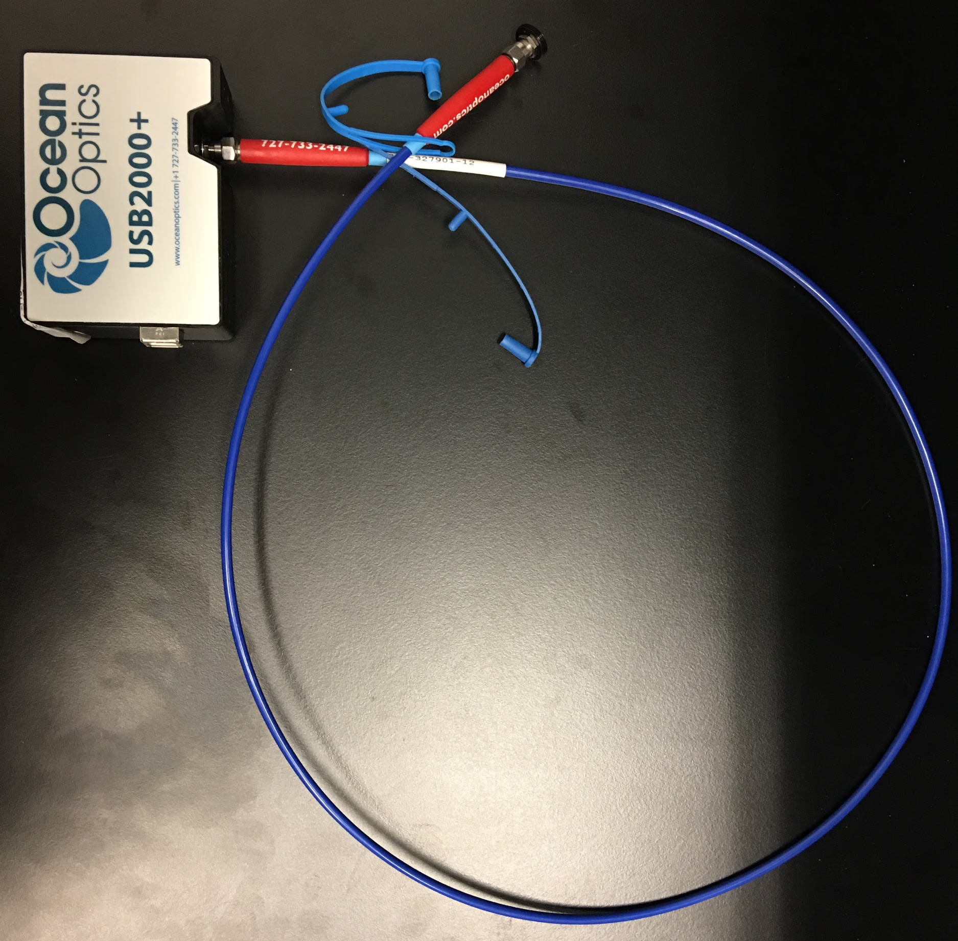
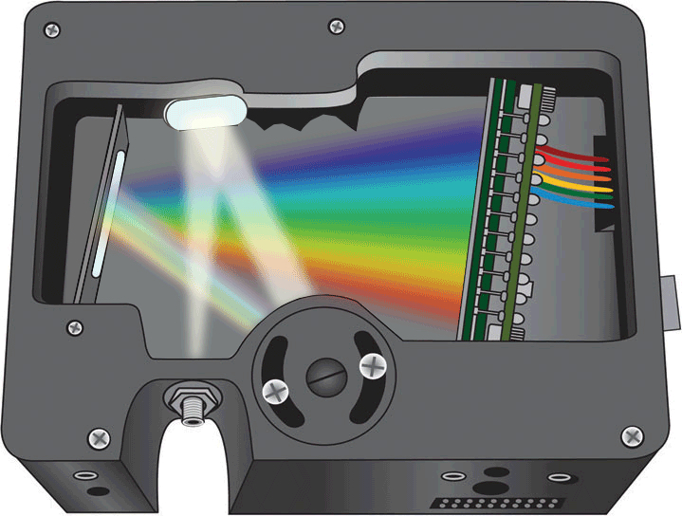
Spectrometer
8.91 cm
Ocean Optics USB2000+
High resolution, high SNR
Raman signal from probe is delivered
to spectrometer via optical fiber
6.33 cm
1 m Fiber

Slide 18
Comparison of Spectrometers
Property | USB2000+ | QE Pro-Raman
Application | General spectroscopy | Raman spectroscopy
Resolution | ~ 39 cm-1 (~ 2.45 nm) | ≥ 6 cm-1 (≥ 0.4 nm)
SNR | 250:1 | 1000:1
Cost |  | ~ $13,500
There are spectrometers more suited for Raman spectroscopy.
USB2000+ was donated by our sponsor.

Slide 19
Comparison of Microcontrollers
Microcontroller | Arduino Uno | MSP4305172 | Raspberry Pi 3
Processor | 16 Mhz Quartz | 25 Mhz Crystal | 1.2 Ghz Quad Core
RAM | 2KB SRAM | 2KB SRAM | 1GB RAM
Drive Space | 32KB Flash | 32KB Flash | 32GB Flash
Other features | 14 DIO Pins, USB | 29 DIO PIns, USB | 40 GPIO Pins, USB
Input Voltage | 7-12 V | 1.8-3.6 V | 5 V
Dimensions | 69 mm x 53 mm | Needs own custom PCB | 121 mm x 76 mm

Slide 20
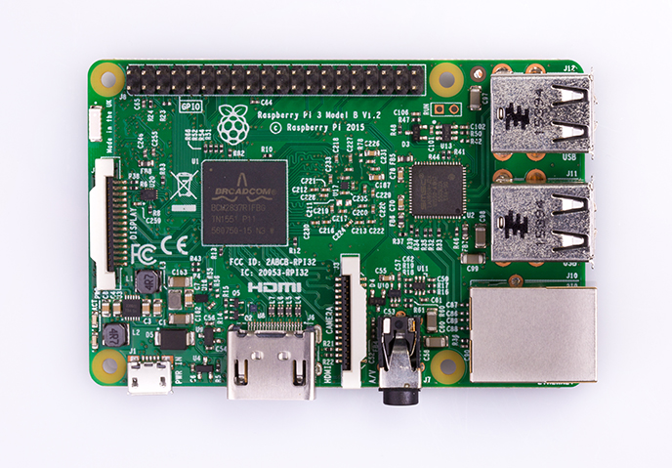
Raspberry Pi 3
85 mm
Important Specifications:
1.2GHz quad-core ARMv8 Processor
1GB Ram
40 GPIO Pins
4 USB Ports
HDMI Port
56 mm

Slide 21
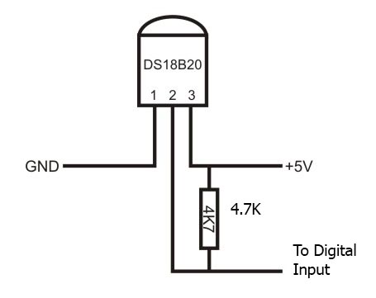
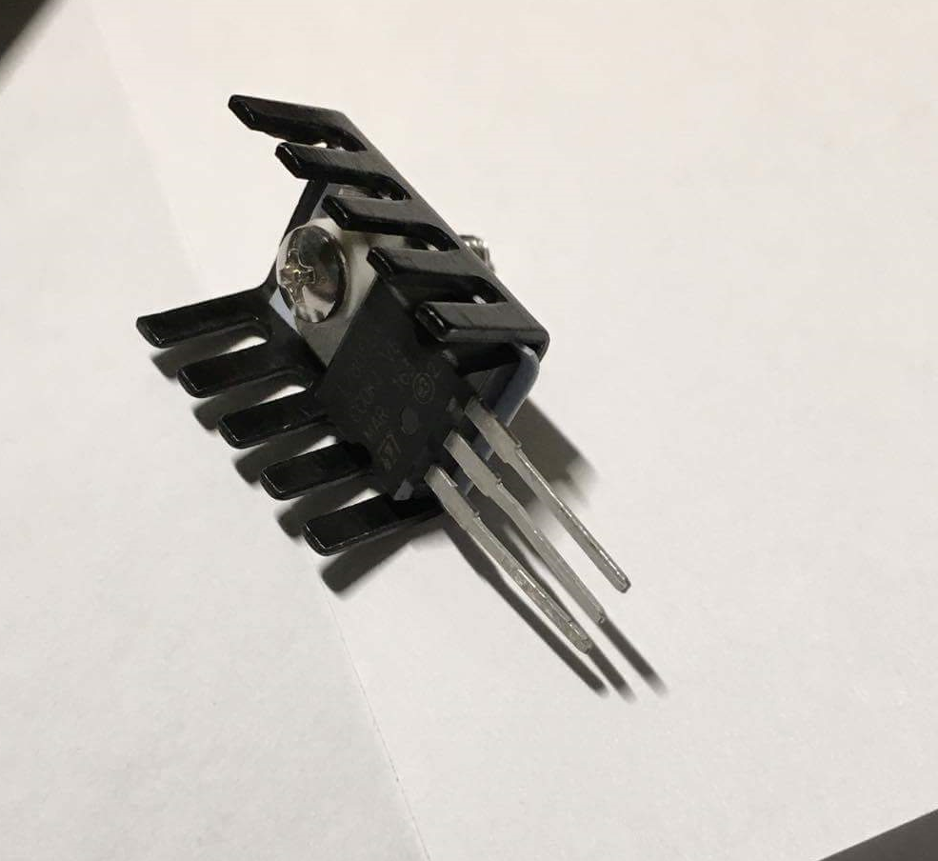
Heat Concerns: Main Body
System Instability- Laser and Microcontroller
User safety
Addressed with:
Temperature Sensor (Dallas DS18B20)
Heat Sinks on TO-220 components
Fan

Slide 22
Probe

Slide 23
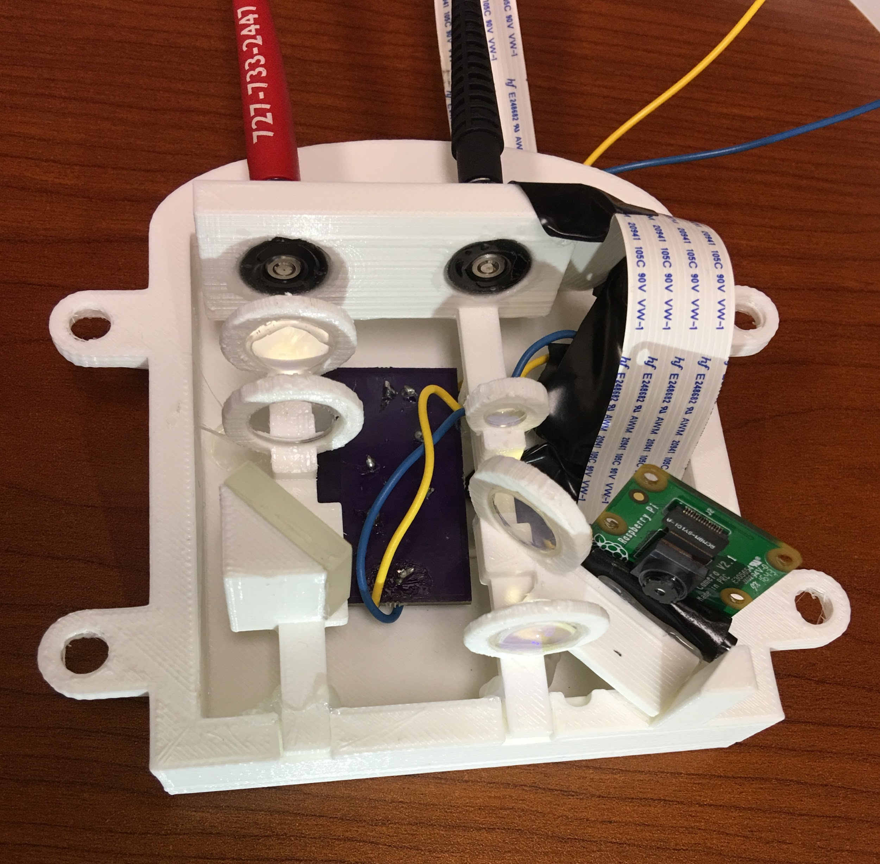
Probe Internals
The optical components are mounted onto a 3D printed custom mount.
The camera module is placed in a position that captures an image of the sample being scanned.
An LED underneath the camera mount helps to illuminate the sample. The PCB for the LED is sitting below the optical mount.

Slide 24
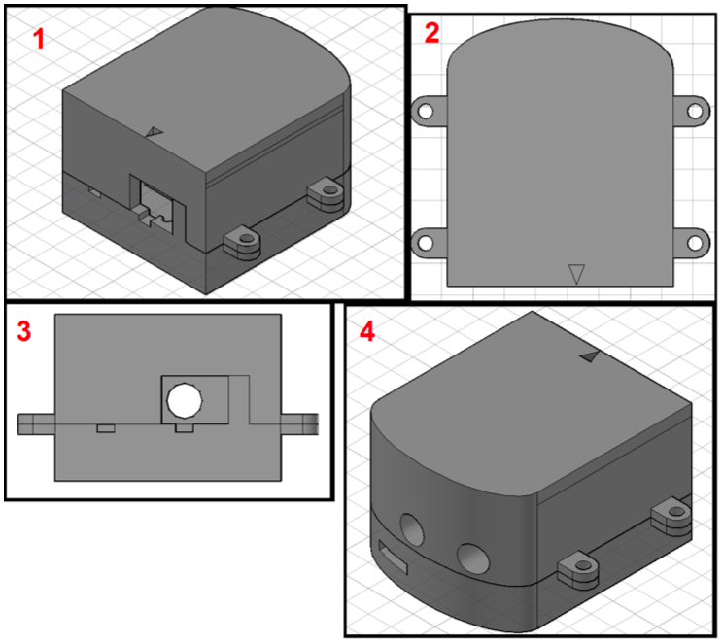
Probe Encasing
Window shown is where the sample is placed
Top-down view, showing the arrow indicating placement of sample
Front view where the focused laser beam exits
Back view, showing openings for

Slide 25
Probe Dimensions
Measured Distance | Dimensions (cm) | Dimensions (in)
Encasing Length (L) | 10.8 | 4.25
Encasing Width (W) | 12.1 | 4.75
Encasing Depth (D) | 6.7 | 2.65
Optical Mount Length (L) | 7.9 | 3.1
Optical Mount Width (W) | 7.1 | 2.8
Optical Mount Depth (D) | 4.0 | 1.59

Slide 26
Comparison of Camera Modules
Brand | Specific Product | Price Range | Megapixels
Adafruit | Raspberry Pi Camera Module V2 | $29.89 | 8.0
Arducam | OV5647 Mini Camera Module for Raspberry Pi | $14.99 | 5.0
SainSmart | Camera Module Board Webcam Video for Raspberry Pi 3 | $13.99 | 5.0

Slide 27
Camera
25 mm
Allows for imaging and visibility of sample
High resolution, small, effective with changes in light
Allow real-time video feedback of sample
Allow for photographing the tested sample
Easy to interface with microcontroller
Adjustable focal length
24 mm
16 mm

Slide 28
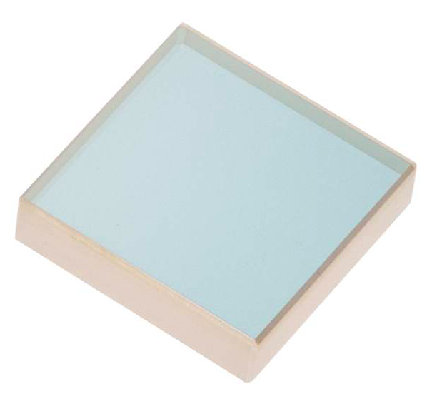
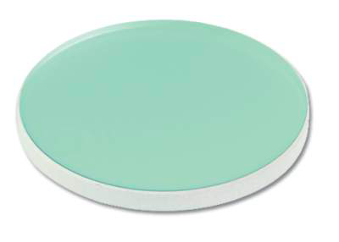
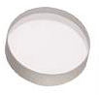
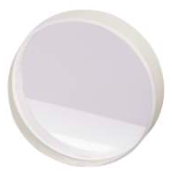
Optics
12.7 mm
19.05 mm
Optical fibers for NIR transmission
AR coated plano-CX lenses for collimation and focusing
Beamsplitter to decrease incident power, redirect Raman signal
Mirror
Longpass filter to diminish Rayleigh signal (785 nm), allow transmission of Raman signal ( > 800 nm)
Longpass Filter
Mirror
6.35 mm
25.4 mm
(1“)
Lens
Beamsplitter

Slide 29
Comparison of Fibers
Property | Excitation Fiber | Collection Fiber
Model | M18L01 | P200-1-VIS-NIR
Manufacturer | Thorlabs | Ocean Optics
Core Diameter | 105 µm | 200 µm
NA | 0.22 | 0.22
Wavelength Range | 400 to 2400 nm

Slide 30
Comparison of Lenses
Property | Collimation Lens | Focusing Lenses
Model | KPX019AR.16 | LA1540-B
Manufacturer | Newport | Thorlabs
AR Coating | 650 to 1000 nm | 650 to 1050 nm
NA | ~ 0.125 | ~ 0.5

Slide 31
Comparison of Beamsplitters
Property | Dichroic | 50/50 | 90/10
Model | DMSP805T | 10Q40BS.2 | BSX05
Manufacturer | Thorlabs | Newport | Thorlabs
Filter | 805 nm cut-off | 50% Reflection 50% Transmission | 90% Reflection 10% Transmission
Coating | AR coated | 700 to 950 nm | 700 to 1100 nm
The dichroic beamsplitter was purchased because the 50/50 beamsplitter available reduced the power and Raman signal too much.

Slide 32
Comparison of Mirrors
Property | 07SD520BD.2 | BB05-E03
Manufacturer | Newport | Thorlabs
Wavelength Range | 700 to 950 nm | 750 to 1100 nm
Reflectance | > 99% | ≥ 99%
Cost | $55.00 | $50.50
The chosen mirror was available in the CREOL Senior Design lab and met the desired functionality.

Slide 33
Comparison of Filters
Property | Longpass | Notch
Model | 5CGA-800 | NF785-33
Manufacturer | Newport | Thorlabs
Wavelength | 800 nm cut-on | 785 nm center wavelength 33 nm FWHM
Transmission | > 90% | > 90%
Cost | $15 | $500
A notch filter is not needed because only larger wavelengths (Stoke’s Raman shift) are of interest for this application.

Slide 34
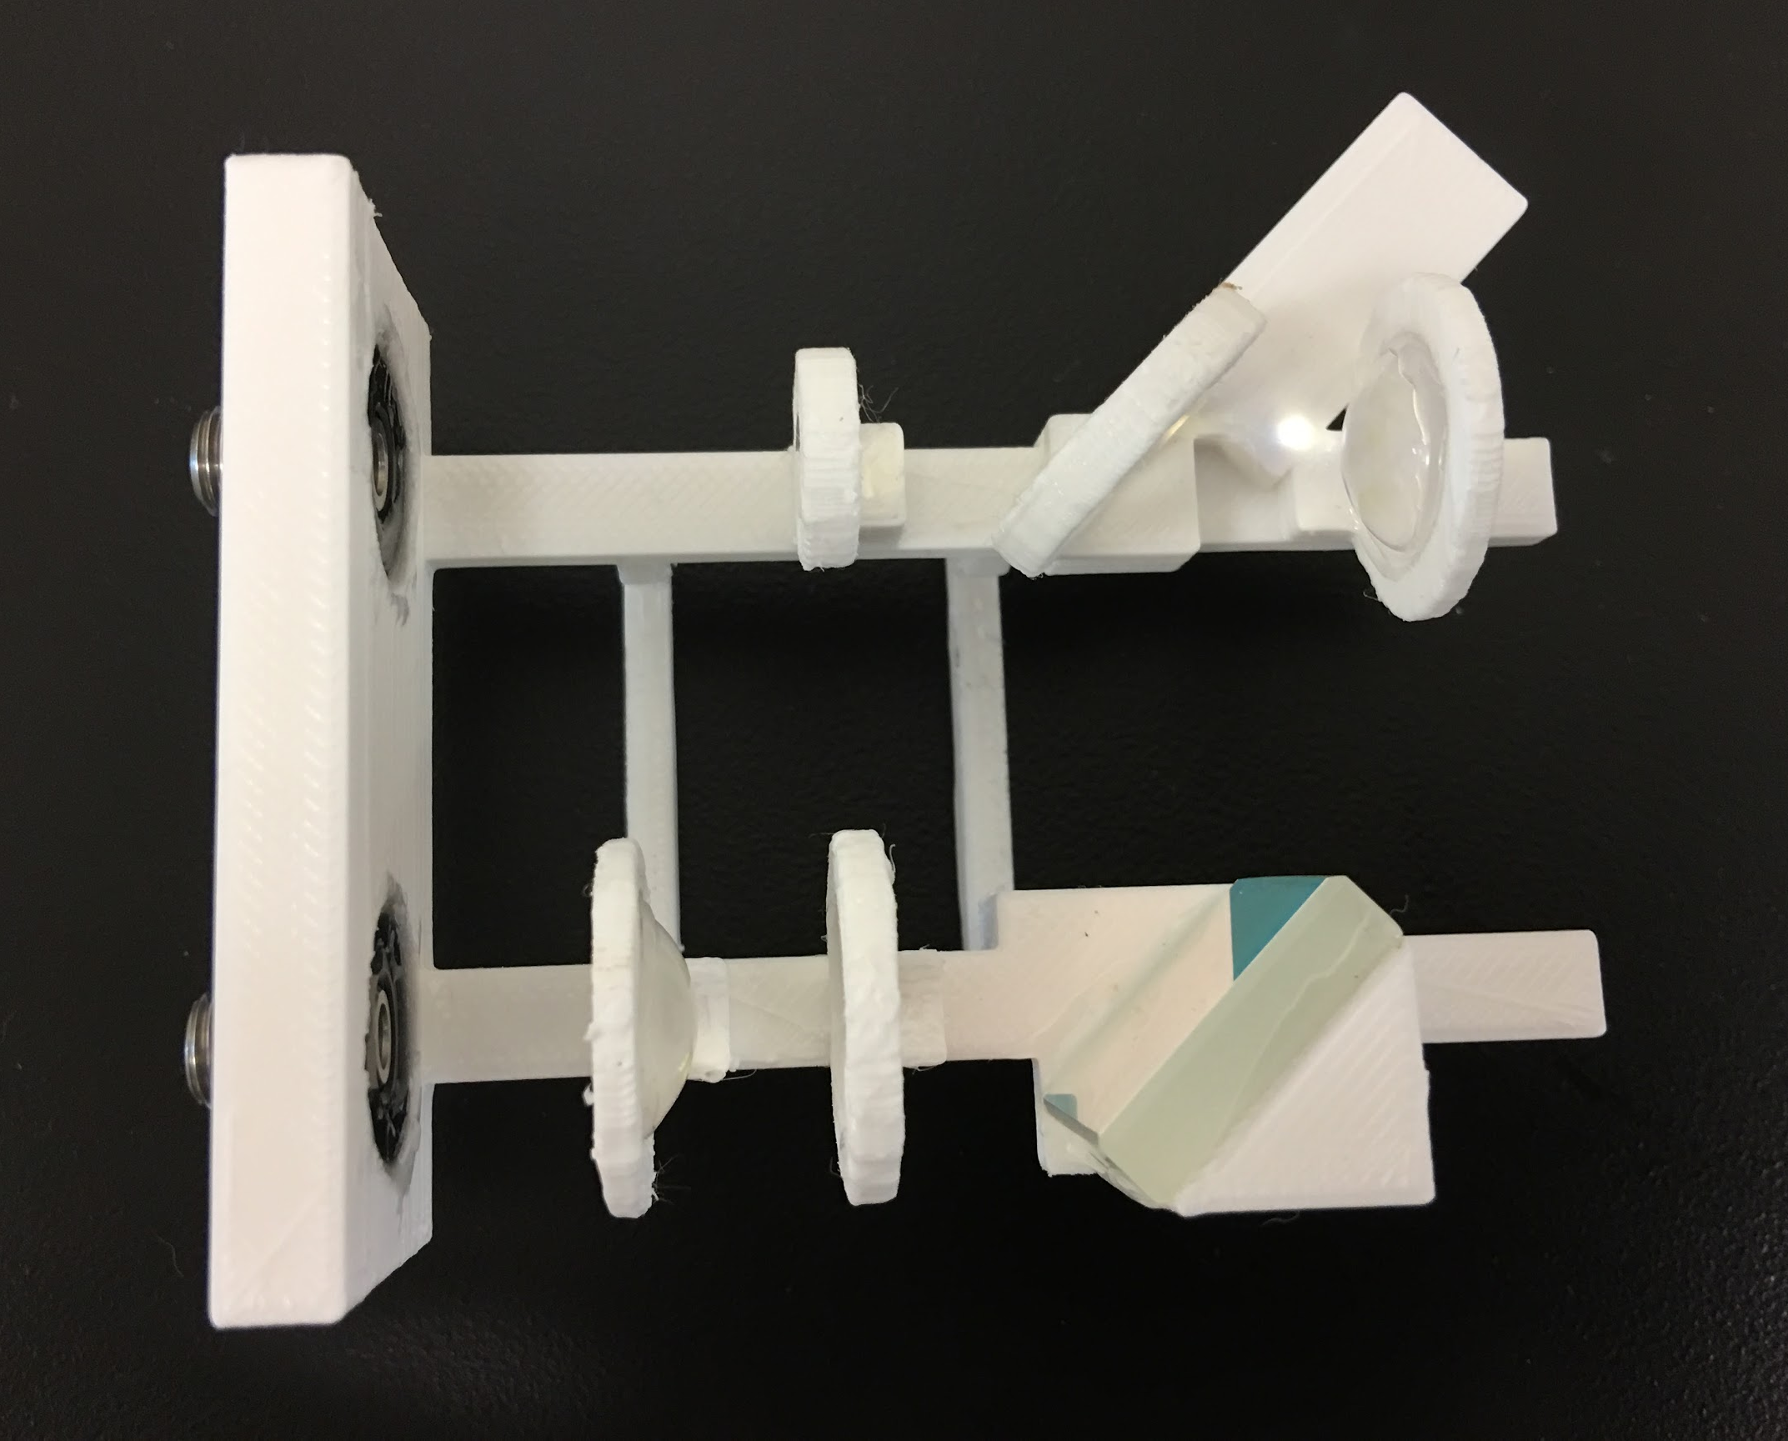
Mounting the Optics Within the Probe
Optics within the probe must be well-aligned and sturdy.
Custom CAD ensures proper alignment and allows for custom-sized optical holders.
3D print is inexpensive, compact, and lightweight.

Slide 35
Computer Systems

Slide 36
System Control
Raspberry Pi
-Controls Camera/Temperature sensor functionality
-Java Capable to eventually run full system program
External Computer
-System Capable of Running Omnidriver Java API
-x86 Based Processor for compatibility w/ OmniDriver
-Controls Spectrometer/Data Analysis functions

Slide 37
Data Collection
Dark Spectrum Analysis-
Use Spectrometer to analyze raman signal without laser input
Run 20 Times to reduce impact of outlier results
~5s Runtime
Laser Spectrum Analysis-
Use Laser/Spectrometer System to Analyze Skin Sample
Run 100 Times to reduce impact of outlier results
~30s Runtime
Laser Spectrum Analysis ( 100 Pass Average)
Dark Spectrum Analysis (100 Pass Average)
Laser Spectrum - Dark Spectrum
Remove Nonlinearity
Apply Smoothing
Return Results
Ensemble Average Smoothing-
Run over all 100 data passes
Reduces SNR by factor of 10-fold on 100 pases

Slide 38
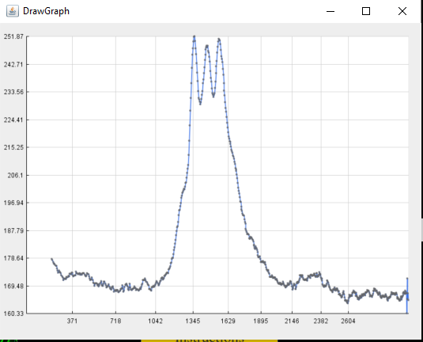
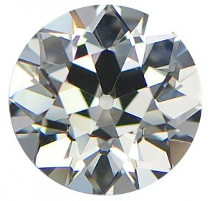
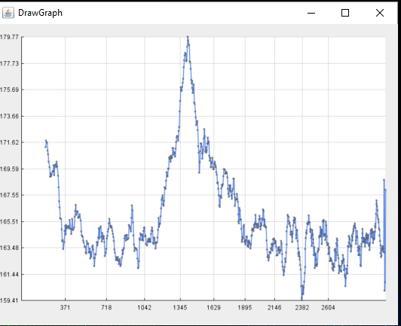
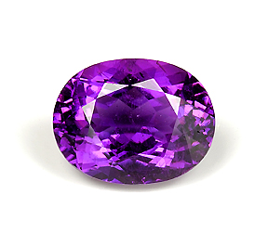
Raman Analysis
-Raman Spectra is analyzed for local maxima
-These critical points are used to identify known compounds
-Algorithm-based determination of which compounds have been tested
Peaks at 1332, 1438, 1533 wavenumbers
Peaks at 1381 wavenumbers

Slide 39
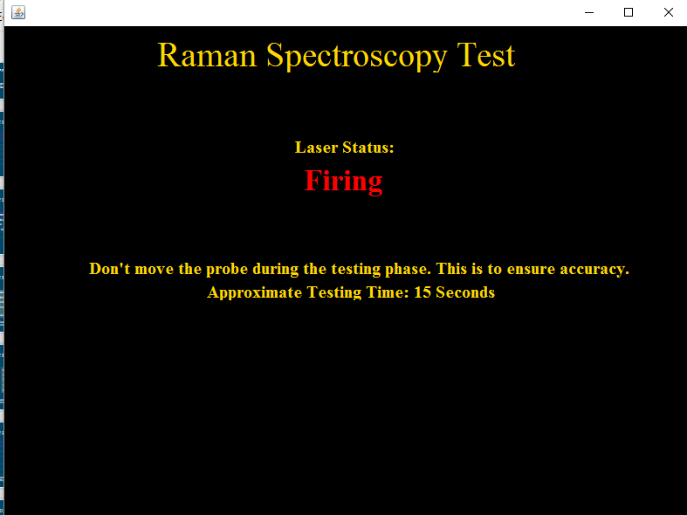
User Interface
Visual representation of the project to end-users
Specifications:
Intuitive
Professional
Minimalistic

Slide 40
Administrative Content

Slide 41
Safety
Personal Protective Equipment (PPE): Laser safety glasses (for testing)
Engineering controls: Protective housing
Laser activation warning
Output power controlled
Administrative & Procedural controls: Proper labelling
Product user manual

Slide 42
Responsibilities
Responsibility | Stephen Esposito | Michael Gonzalez | Chelsea Greene | Megan Melvin
Physical Design |  | Primary |  | Secondary
Probe PCB |  | Primary | Primary
Power PCB |  | Secondary | Primary
Data Analysis | Primary |  |  | Secondary
User Interface | Primary |  | Secondary
Optics | Secondary |  |  | Primary
Laser Safety |  |  | Secondary | Primary

Slide 43
Expenses
Item | Specific Model | Manufacturer | Qty | Cost per Item
PCB A V2 | - | OSH Park | 1 | $43.00
PCB B | - | OSH Park | 1 | $7.23
Switch | Rocker Switch-SPST | Sparkfun | 1 | $0.95
Fiber Optic Cable | M18L01 | Thorlabs | 1 | $75.75
Fiber Adaptor Plates | SM05SMA | Thorlabs | 2 | $28.00
Longpass Filter | 5CGA-800 | Newport | 1 | $15.00
Microcontroller | Raspberry Pi 3 Model B | Raspberry Pi | 1 | $35.00
Optical Mount | - | Minimalist Ventures | 1 | $5.00
Probe Casing | - | Minimalist Ventures | 1 | $25.00

Slide 44
Item | Specific Model | Manufacturer | Qty | Cost per Item
Main Body Casing | - | - | 1 | $24.00
Temperature Sensor | DS18B20+ | Maxim Integrated | 1 | $3.13
CMOS Camera | Raspberry Pi Camera Module V2 | Adafruit | 1 | $29.89
Heatsinks, mounts |  |  | 12 | $3.79
Wall Adapter Charger Power Supply | 9V DC 2A |  | 1 | $8.99
5 V Voltage Regulator | L7805 |  | 2 | $0.80
Flex Cable | ADA2144 | Adafruit | 1 | $12.49
Additional Cables, Ports |  |  |  | $2.61
Additional Electronics | LEDs, transistors, etc. |  |  | $49.08
TOTAL |  |  |  | $369.61

Slide 45
Non-incurred Expenses
Item | Specific Model | Manufacturer | Qty | MSRP
Multimode Spectrum Stabilized Laser Subsystem (785 nm) | LASER-785-IP-02-1208 | Ocean Optics | 1 | $8,333.00
Spectrometer | USB2000+VIS | Ocean Optics | 1
Probe |  | InPhotonics | 1
Lenses | KPX019AR.16 | Newport | 3 | $63.00 ea
Mirror | 07SD520BD.2 | Newport | 1 | $55.00
Fiber Optic Cable |  | Ocean Optics | 1

Slide 46
Future Improvements
Use non-linear voltage regulators
Omni Driver compatibility with ARM-based processors to allow for 1-system functionality
Add a crosshair to the camera feed to indicate where the laser is focused
Redesign probe for smaller size, and more intuitive targeting
Redesign main casing

Slide 47
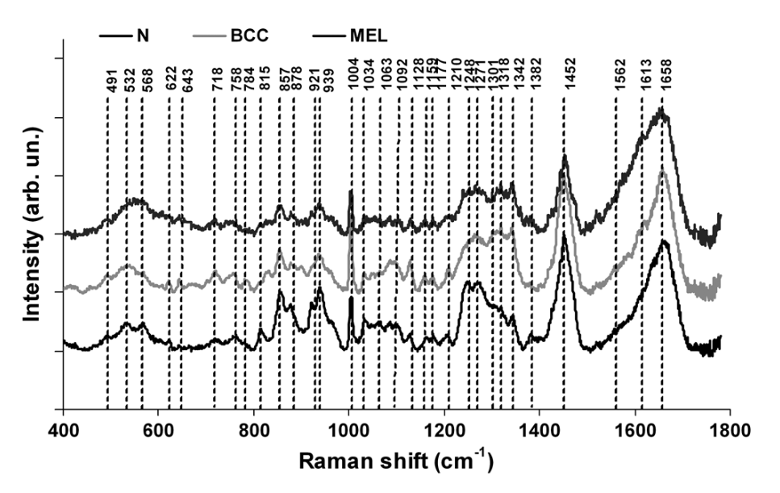
Future Application
Use Raman spectroscopy to identify different types of cancerous skin cells
Can examine the amide protein bands
Can be performed in vivo
Benefits of Raman:
Non-invasive
Non-destructive
Fast results
Average normalized spectra of normal skin, basal cell carcinoma, and melanoma, showing differences in relative intensities and peak wavelengths.
[DOI: 10.1117/1.JBO.17.7.077003]

Slide 48
Questions?

